Slide 1
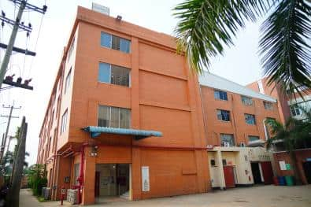

WELLDONE APPAREL LTD.

Slide 2
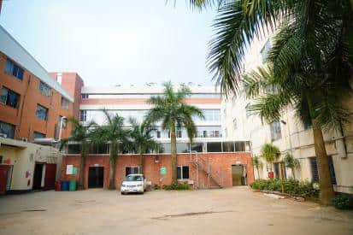
TABLE OF CONTENTS
ABOUT COMPANY
VISION & MISSION
OUR CUSTOMERS
CERTIFICATIONS
QUALITY CONTROL SOP
MACHINERIES & CAPACITY
FACTORY OVERVIEW
OUR PRODUCTS
SUSTAINABILITY
CONTACT

Slide 3
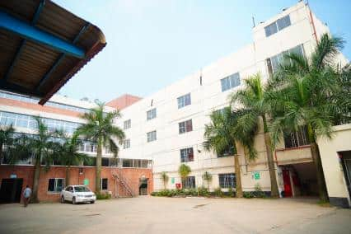
ABOUT COMPANY
The concept of challenging the prevailing norms and beliefs can frequently function as a driving factor that propels individuals towards progress. The formation of MNR in 1998 was facilitated by the concept, which was underpinned by self-assurance and a constructive mental attitude. Our highly regarded Managing Director, Mr. Golam Mostofa, demonstrated a willingness to embrace the concept of rejuvenation at his young age by making the bold choice to transition from his stable role to pursue the stimulating path of entrepreneurship.
Mr. Mostofa demonstrated a high level of confidence, determination, and forward-thinking as He undertook the endeavor of establishing own manufacturing enterprise. In 1998, He has effectively led the establishment of a state-of-the-art Flat knitwear manufacturing business, commencing operations with a modest fleet of 350 machines. The establishment of WELLDONE APPAREL LTD. , renowned for its high-quality flat knitwear manufacturing.
The representation was enthusiastically accepted by the apparel companies, leading to the emergence of yields that garnered prominence and were favorably welcomed by high street clothing brands.

Slide 4


VISION & MISSION
To be the number one premier industrial group in Bangladesh , by increasing production and export volumes with exceptional performance.
Establish a strong global presence by exporting premium sweaters to international markets.
Commit to eco-friendly practices by using sustainable fabrics, ethical sourcing, and reducing waste.
Focus on customer satisfaction by offering trendy, comfortable, and affordable sweater options.
Continuously evolve by incorporating innovative knitting techniques, unique designs, and the latest fashion trends.
Manufacture high-quality, durable, and stylish sweaters that meet global standards.
Provide a safe, inclusive, and growth-oriented work environment for employees, ensuring fair wages and skill development.

Slide 5
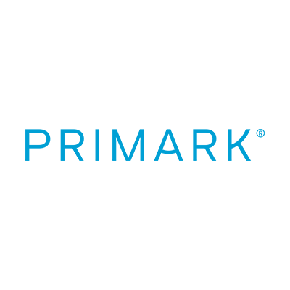
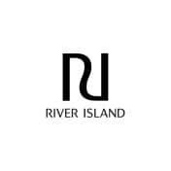
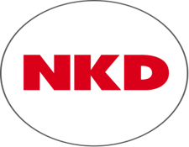

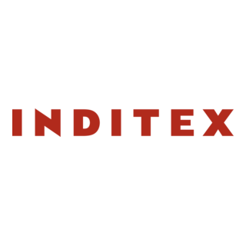
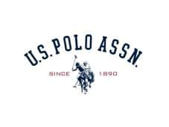
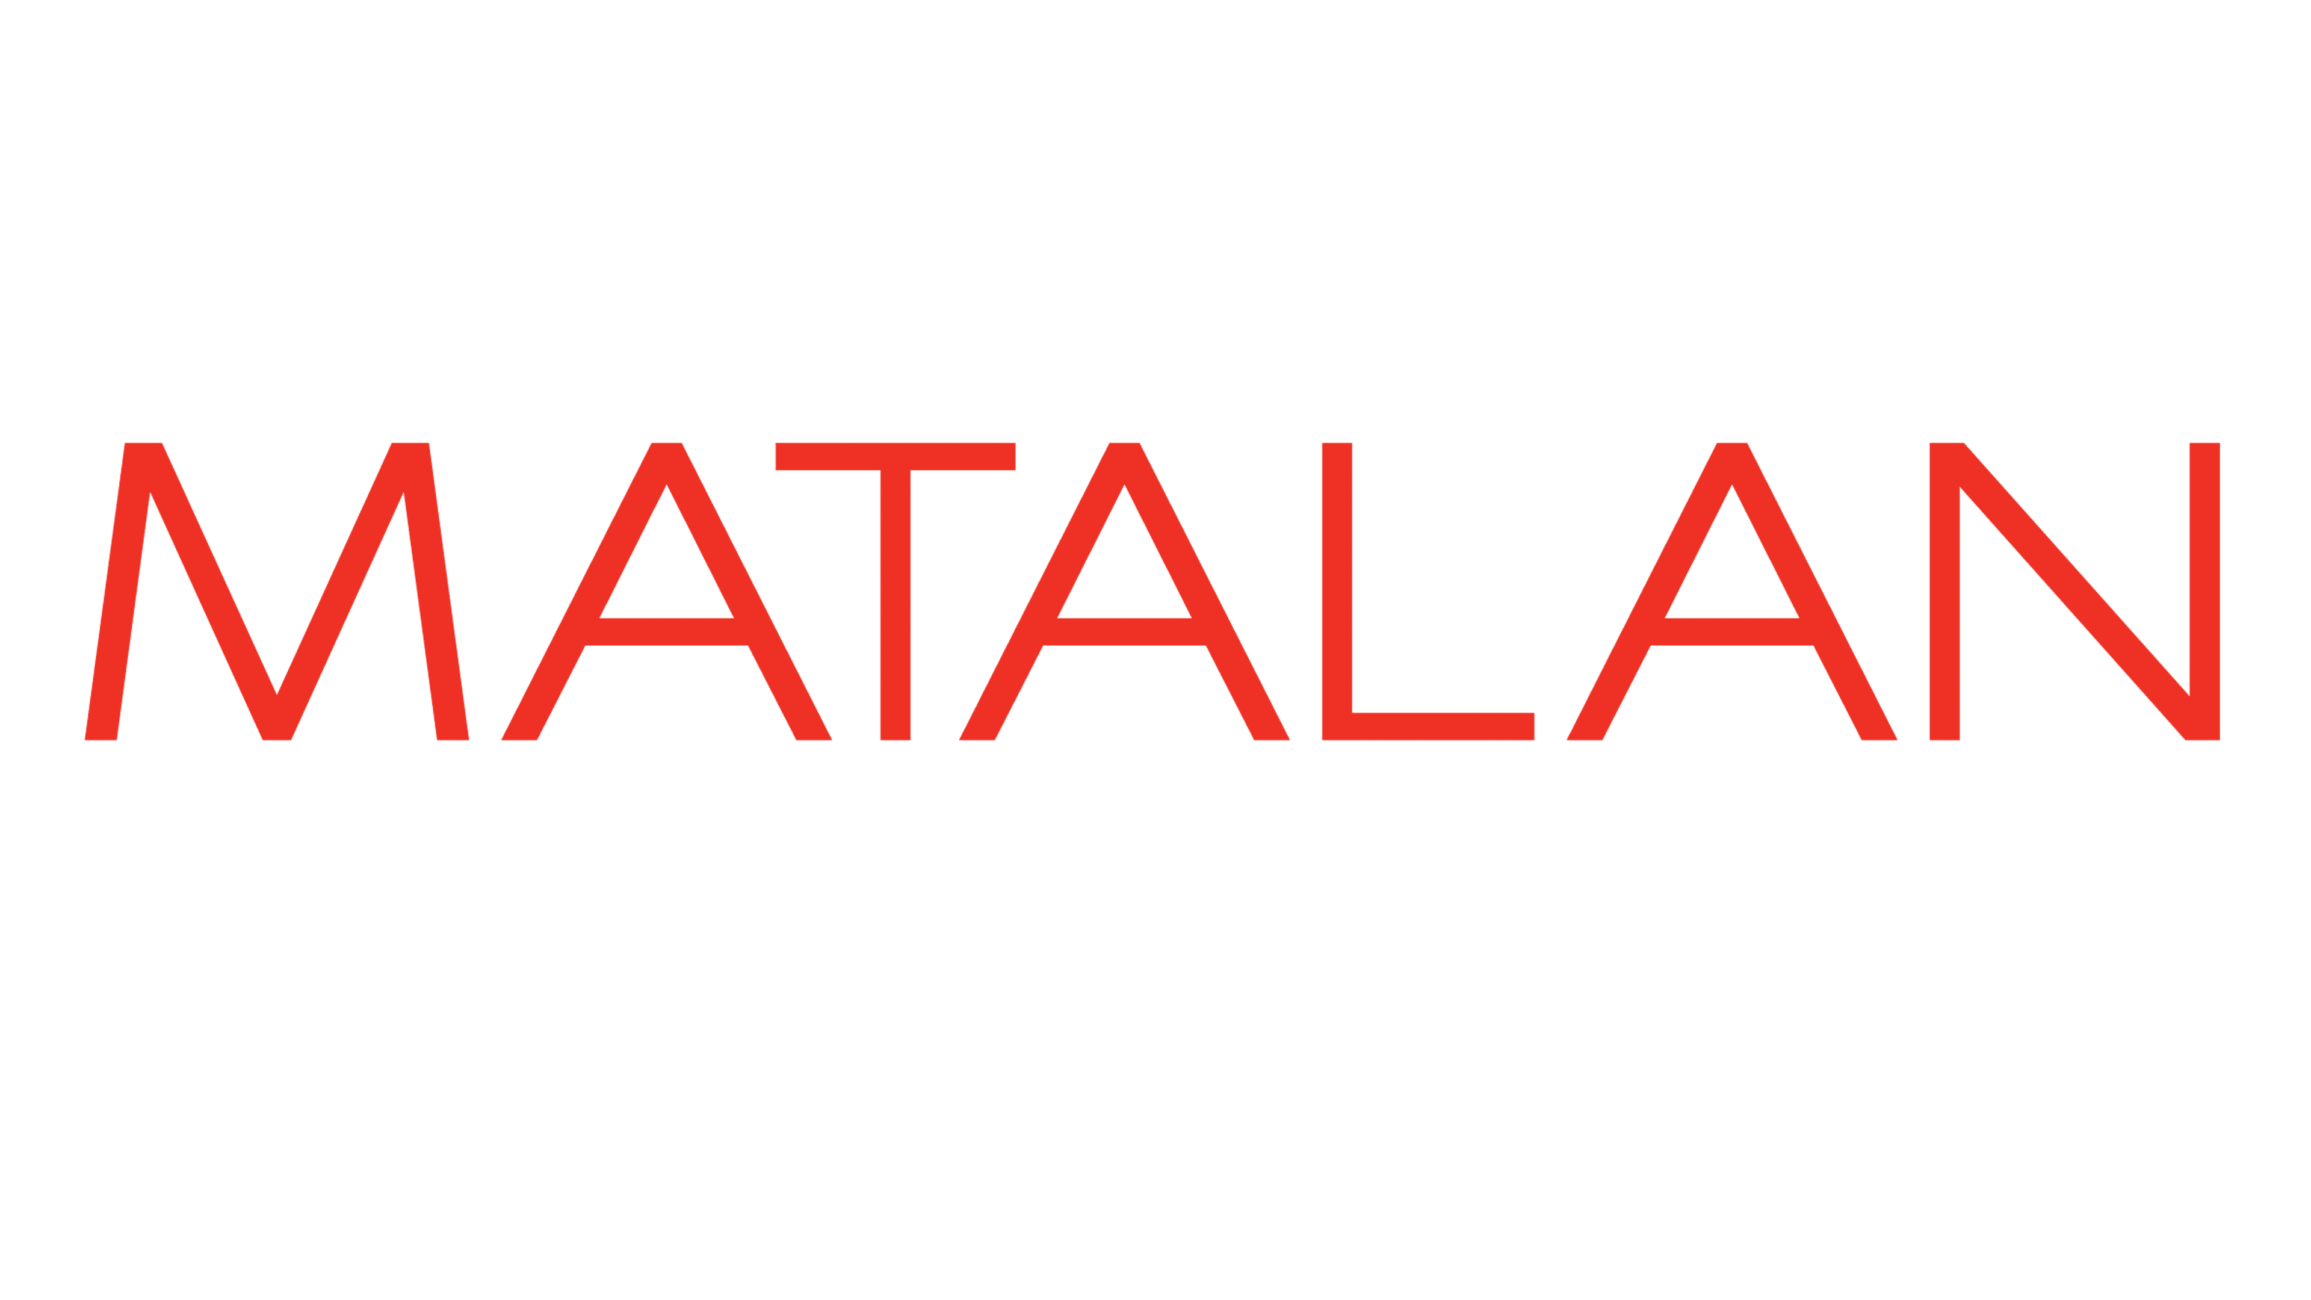



OUR CUSTOMERS

Slide 6
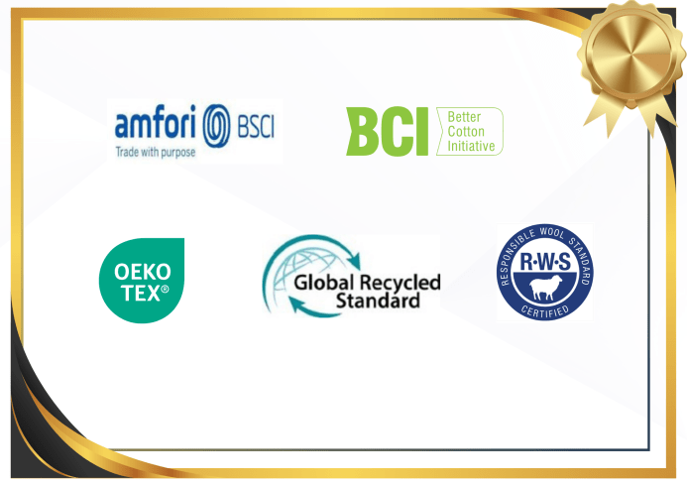
CERTIFICATIONS

Slide 7
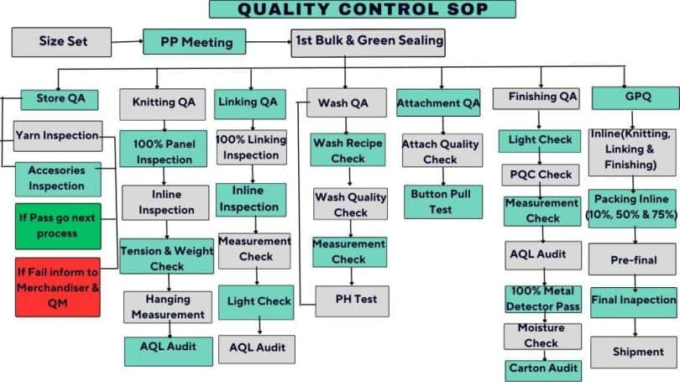

Slide 8
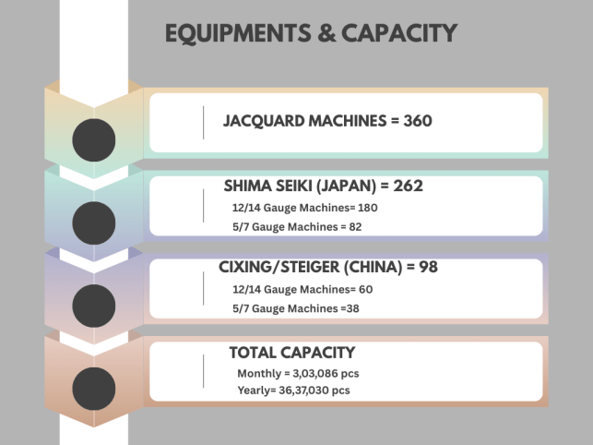
MACHINERIES & CAPACITY

Slide 9
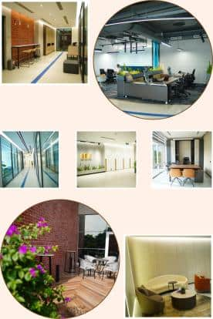
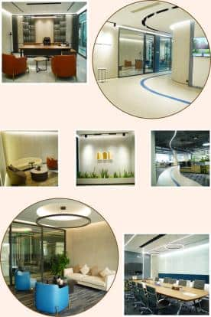
FACTORY OVERVIEW

Slide 10
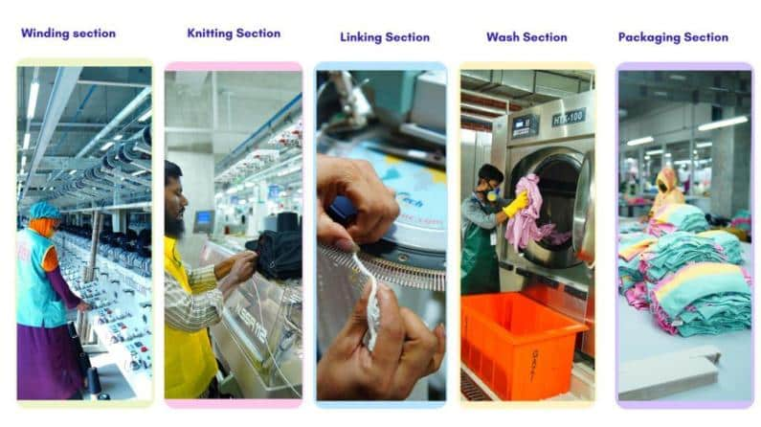
FACTORY OVERVIEW

Slide 11
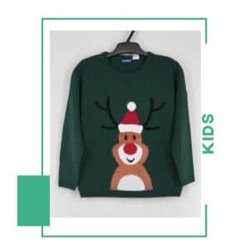
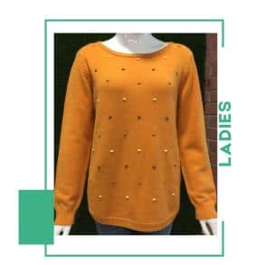
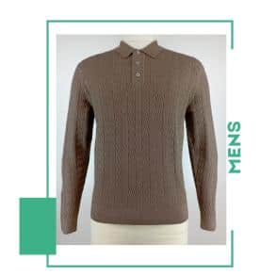
OUR PRODUCTS

Slide 12

SUSTAINABILITY
Use organic, recycled, or sustainably sourced wool, cotton, or synthetic fibers.
Reduce water and energy consumption in the knitting and dyeing process.
Implement waste management strategies.
Ensure fair wages and safe working conditions for workers.
Use renewable energy sources in production facilities.
Use biodegradable, recyclable, or reusable packaging materials.
Minimize packaging waste by opting for simple, eco-friendly designs.
Optimize transportation and logistics to reduce emissions.

Slide 13






CONTACTS
Feel free to reach out to us for further information!
Bank Details
Mercantile Bank Ltd.
Gulshan Branch,106 Gulshan Avenue. Dhaka 1212, Bangladesh.
Phone #+880-028835276
Fax # +880-02-8835614.
SWIFT: MBLBBDDH019
Name: Golam Mostofa
Managing Director
Cell : +880 1929913111
E-mail: mostofa@mnrgroupbd.com
Corporate Office
House :488 (1st & 2nd Floor),Road : 8, Baridhara DOHS ,Dhaka-1206.
Factory Office
Baraider Chala, Sreepur, Gazipur, Bangladesh.
Name: Md . Rafiqul Islam
General Manager
(Marketing & Merchandising)
Cell : +880 1929913150
E-mail : rafique@mnrgroupbd.com

Slide 14


